Slide 1


Slide 2
LOC Shelter and Homelessness Webinar Friday, May 21, 2021
1:00 – 2:30 p.m.
Welcome
Ariel Nelson, League of Oregon Cities
Project Turnkey Update
Megan Loeb, Oregon Community Foundation
Legislative Update – Shelter and Homelessness Bills
Ariel Nelson, League of Oregon Cities
HB 2006 – Emergency shelter siting (effective May 6)
HB 3261 – Motel conversion (effective May 12)
HB 3115 – Local ordinances related to homelessness and public space
HB 3124 – Campsite removal notice
Homeless Data and Resources
Connor McDonnell, Oregon Housing and Community Services
Future LOC Programming on Housing and Homelessness – Discussion
Ariel Nelson, League of Oregon Cities

Slide 3

Megan Loeb
Oregon Community Foundation

Slide 4
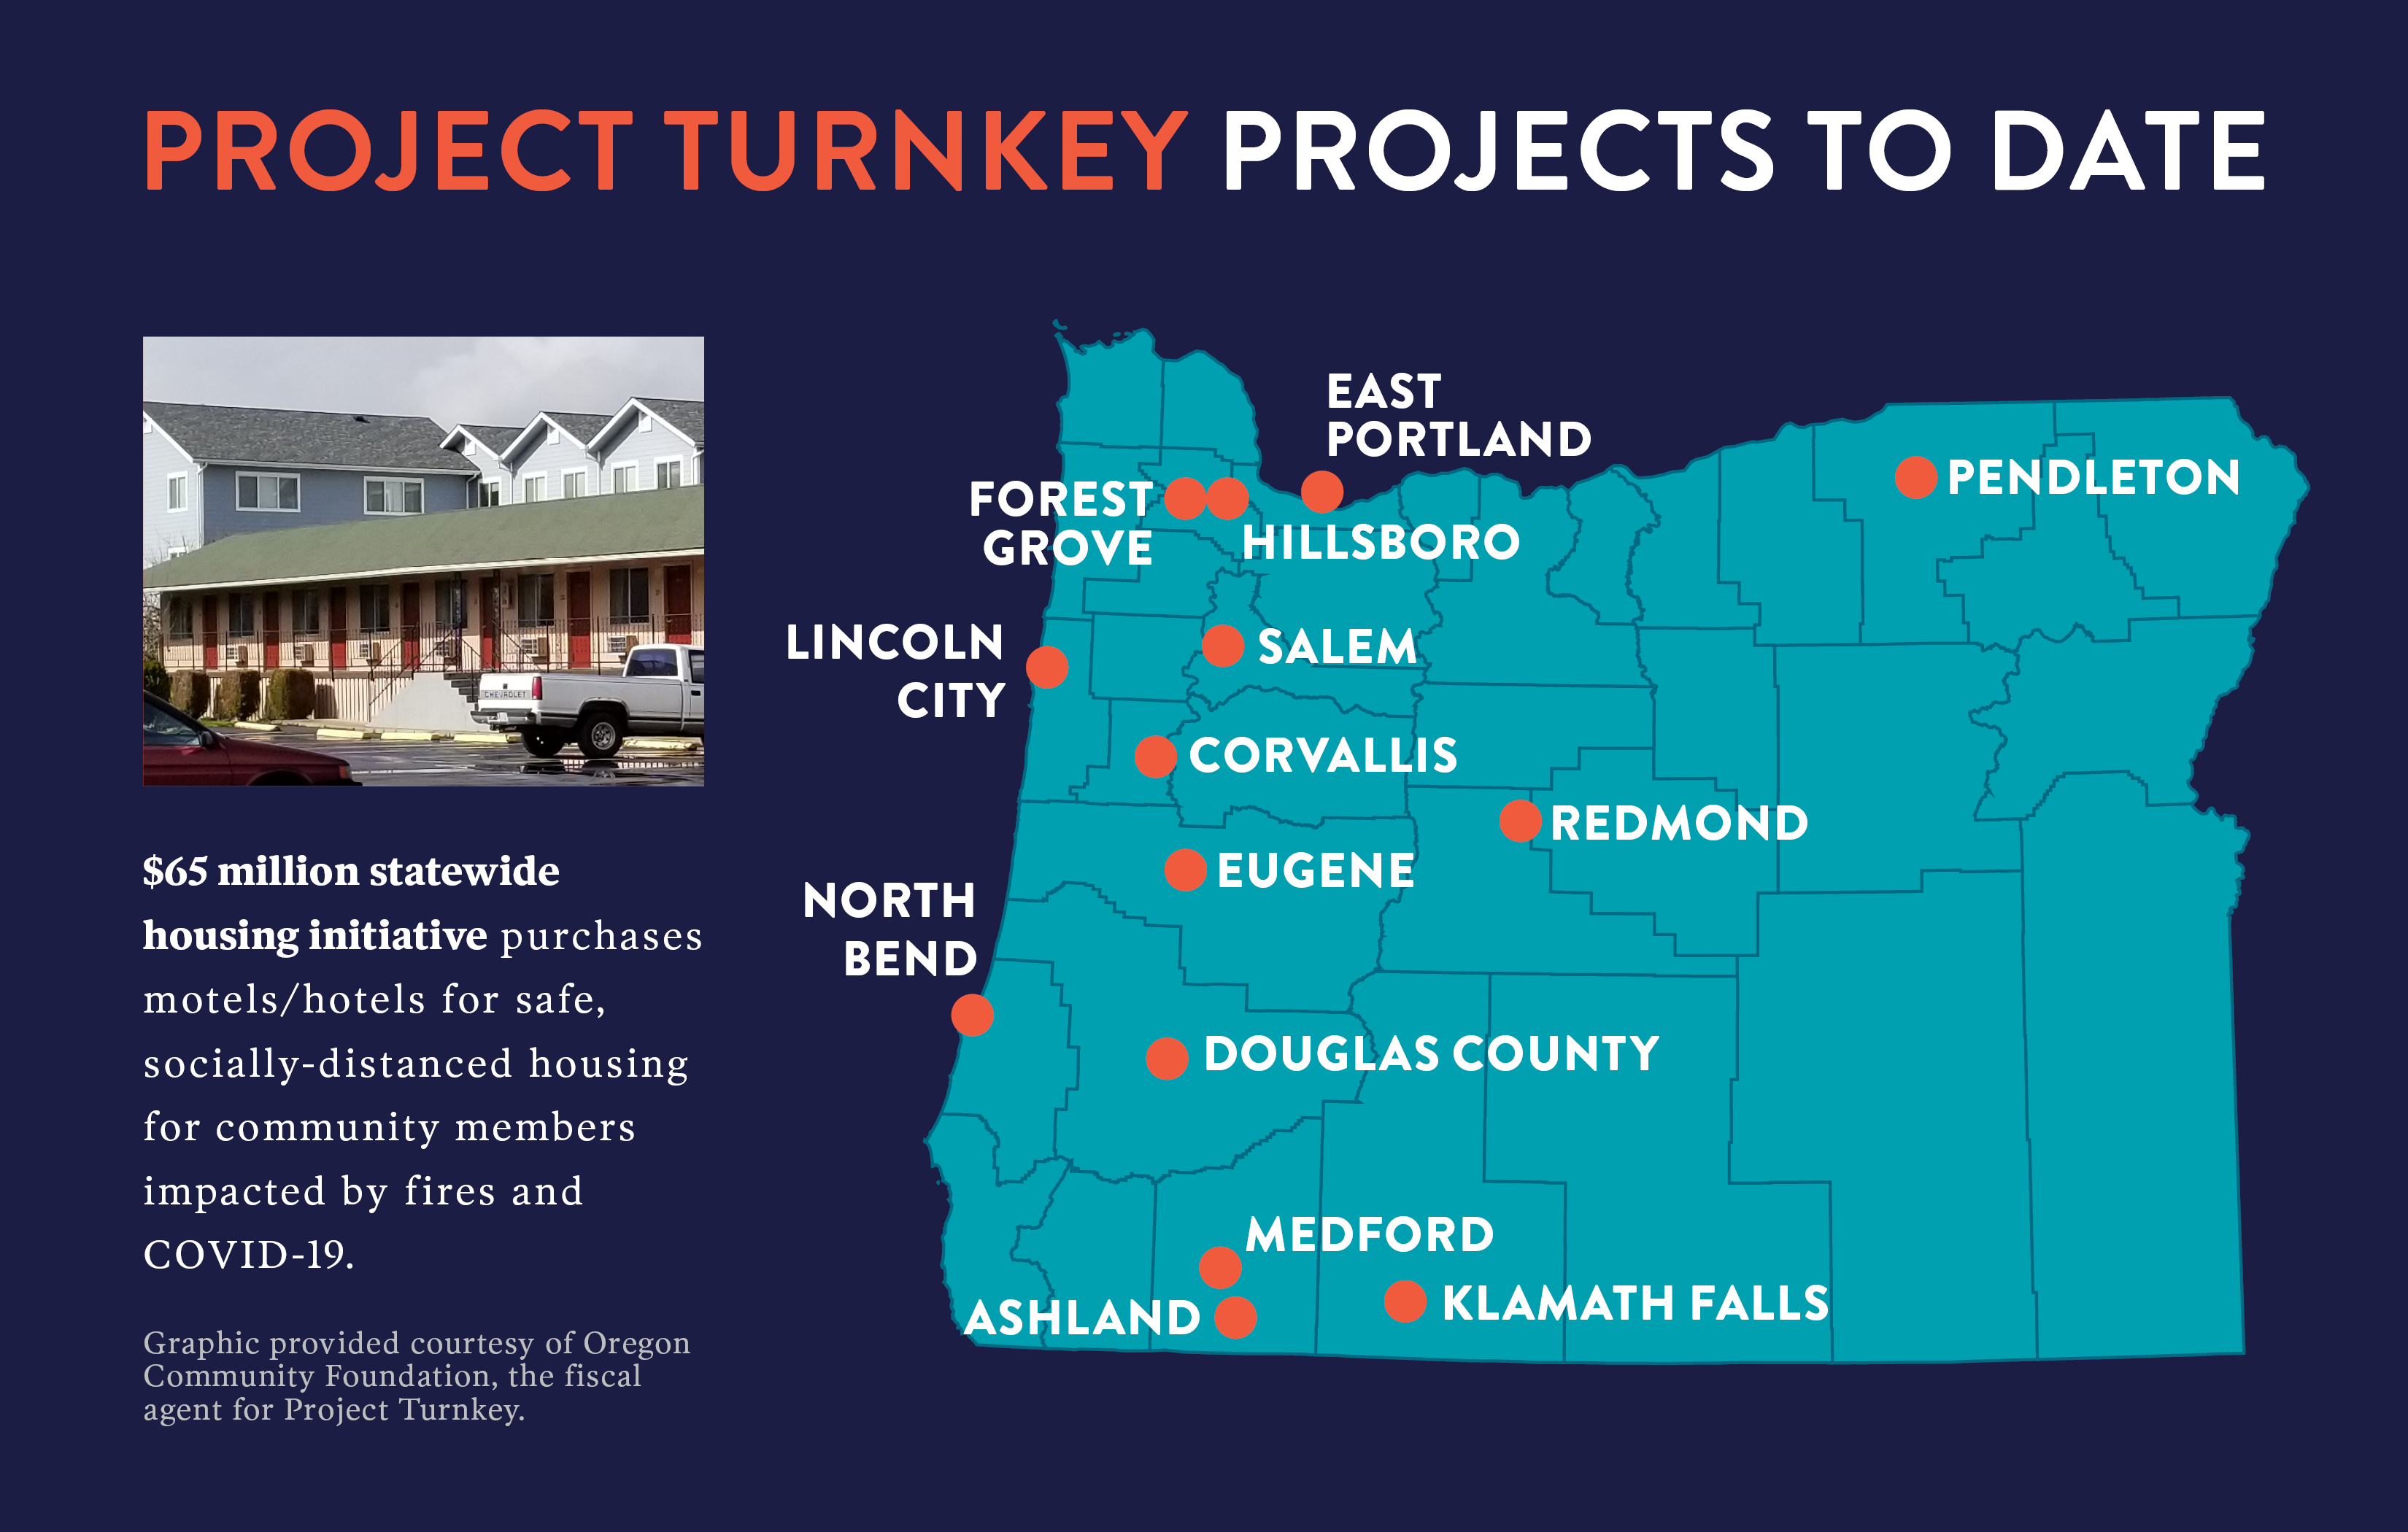

Slide 5
HB 2006 – Emergency Shelter Siting
Governor Brown signed HB 2006 into law on Wednesday, May 12, which passed the Legislature with strong bipartisan support.
The new law takes effect immediately and requires local governments to approve an application for an emergency shelter regardless of state or local land use laws, if the application meets specific approval criteria outlined in the bill.
In other words, a city cannot deny an application to develop an emergency shelter if the application complies with HB 2006, even if the city’s land use code would prohibit the emergency shelter at that location.

Slide 6
HB 2006 – Not a land use decision
Removes state requirements for mailed notice, public hearing, or solicitation of public comment on an application
No requirement for a city to make a decision within a particular period of time
Decisions under HB 2006 may not be appealed to the Land Use Board of Appeals but may be appealed using the writ of review process provided under ORS 34.010 – 34.100
HB 2006 – Effective Dates
The siting authority in HB 2006 sunsets on July 1, 2022, but shelters approved under the bill may remain in operation after the sunset. Should a shelter cease to operate, the regular land use regulations would apply again.
Cities must approve qualifying applications that are completed and submitted between May 12, 2021 and July 1, 2022.

Slide 7
HB 2006 – Shelter Requirements
Cities must approve an emergency shelter for operation on any property if the emergency shelter:
Includes sleeping and restroom facilities
Complies with applicable building codes
Is located within an urban growth boundary or in a rural residential zone
Will not result in a new building that is sited within an area designated under a statewide land use planning goal relating to natural disasters and hazards (e.g. flood plains or mapped environmental health hazards) unless the development complies with regulations directly related to the hazard
Has adequate transportation access to commercial and medical services; and
Will not pose any unreasonable risk to public health or safety.
To qualify, an emergency shelter must be operated by:
A local government; or
An organization with at least two years’ experience operating an emergency shelter using best practices that is:
A housing authority
A religious corporation
A public benefit corporation whose charitable purpose includes the support of homeless individuals and that has been recognized as exempt from income tax under section 501(a) of the Internal Revenue Code on or before January 1, 2018; or
A nonprofit corporation partnering with any of those entities.

Slide 8
HB 2006 – Permissive Shelter Provisions
An emergency shelter may provide on-site and at no cost:
Showering and bathing facilities
Personal property storage
Laundry
Food service
Recreation areas for children and pets
Case management services, or
Any other services incidental to the shelter
An emergency shelter may include youth shelters, veterans' shelters, winter or warming shelters, day shelters and family violence shelter homes.
An emergency shelter may provide additional transitional housing services at a fee of not more than $300/month.

Slide 9
HB 2006 – Vehicle Camping
Any political subdivision may allow any public or private entity to allow overnight camping by homeless individuals living in vehicles on the property of the entity.
A political subdivision may impose reasonable conditions upon offering camping space under this section, including establishing a maximum number of vehicles allowed.
Entities providing camping spaces under this section must also provide access to sanitary facilities, including toilet, handwashing and trash disposal facilities.

Slide 10
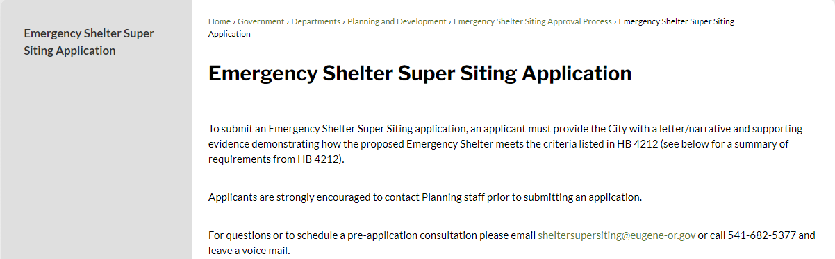
HB 2006 – Implementation
Local examples implementing HB 4212 (2020)
City of Eugene Emergency Shelter Siting Website
Applicant required to provide city with a letter/narrative and supporting evidence demonstrating that proposed shelter meets bill criteria

Slide 11
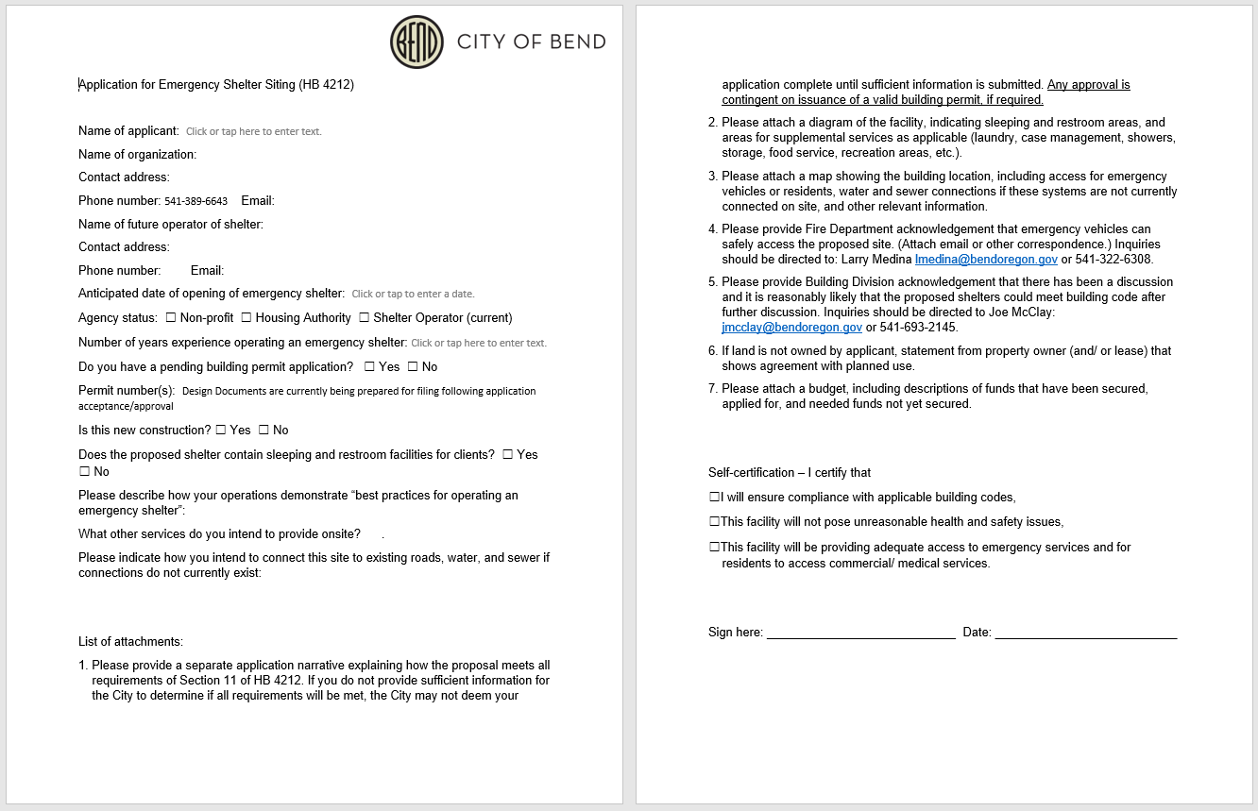
City of Bend – Example Application for HB 4212 (2020)

Slide 12
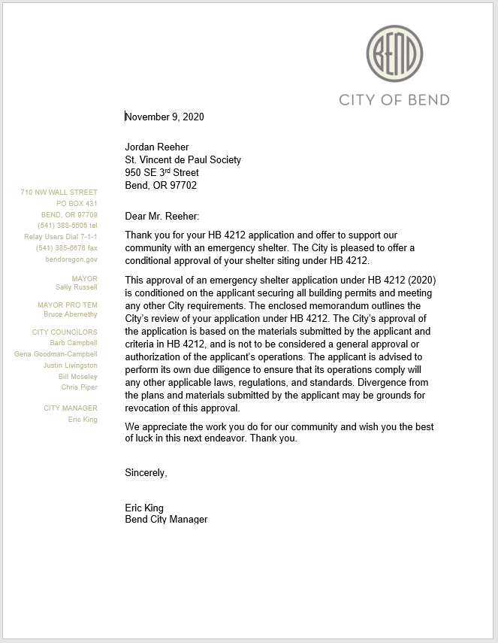
City of Bend Example Approval for HB 4212 (2020)
Conditional letter of approval
Conditioned on the applicant securing all building permits

Slide 13
HB 3162 – Hotel/Motel Conversion
HB 3261 was signed into law on Thursday, May 6, and is now in effect. This new law requires local governments to allow the conversion of hotels and motels into an emergency shelter or affordable housing, regardless of state or local land use laws, if the application meets specific approval criteria. The measure only applies to hotel or motel properties in areas:
Within an urban growth boundary;
Outside heavy industrial zones;
With adequate transportation access to commercial and medical services; and
Not within an area designated for a statewide land use planning goal relating to natural disasters or hazards, including flood plains or mapped environmental health hazards, unless the converted use complies with regulations directly related to the disasters or hazards.
Cities may still require the converted use to comply with building codes, occupancy limits, and reasonable siting and design standards so long as the standards do not, individually or cumulatively, prohibit the conversion through unreasonable costs or delay.
HB 3261 applies to hotel and motel conversions or applications for conversions submitted on or after January 1, 2021.

Slide 14
HB 3115 – Local Homeless Ordinances
Under the direction of Speaker Kotek, the LOC participated in a workgroup effort this past fall with the Oregon Law Center (OLC) as well as individual cities and counties. The workgroup spent many hours crafting a concept that recognizes a key principle from the recent Martin v. City of Boise federal court decision.
Requires that any city or county law regulating the acts of sitting, lying, sleeping or keeping warm and dry outside on public property must be “objectively reasonable” based on the totality of the circumstances as applied to all stakeholders, including persons experiencing homelessness.
Preserves the ability of cities to manage public spaces effectively for the benefit of the entire community
Recognizes that what is objectively reasonable will look different in different communities.
Delayed implementation date of July 1, 2023, to allow local governments time to review and update ordinances and support intentional community conversations. The LOC and OLC will partner to provide guidance to cities. Emergency clause to allow jurisdictions to begin immediately the development of ordinances in order to meet the July 2023 compliance deadline.

Slide 15
HB 3124A – Campsite Removal Procedures
Extends requirement for law enforcement to provide written notice before removing homeless individuals from an established camping site from 24 hours to 72 hours.
Requires jurisdictions to store unclaimed personal property in a facility locate din the same community as the camping site from which it was removed.
Preserves notice exceptions when:
There are grounds for law enforcement officials to believe that illegal activities other than camping are occurring at an established camping site;
In the event of an exceptional emergency at an established camping site, including, but not limited to, possible site contamination by hazardous materials, a public health emergency or other immediate danger to human life or safety.

Slide 16


OREGON HOUSING AND COMMUNITY SERVICES
League of Oregon Cities –
Homeless Services Webinar
Connor McDonnell, Housing Integrator
Oregon Housing and Community Services
May 21st, 2021

Slide 17
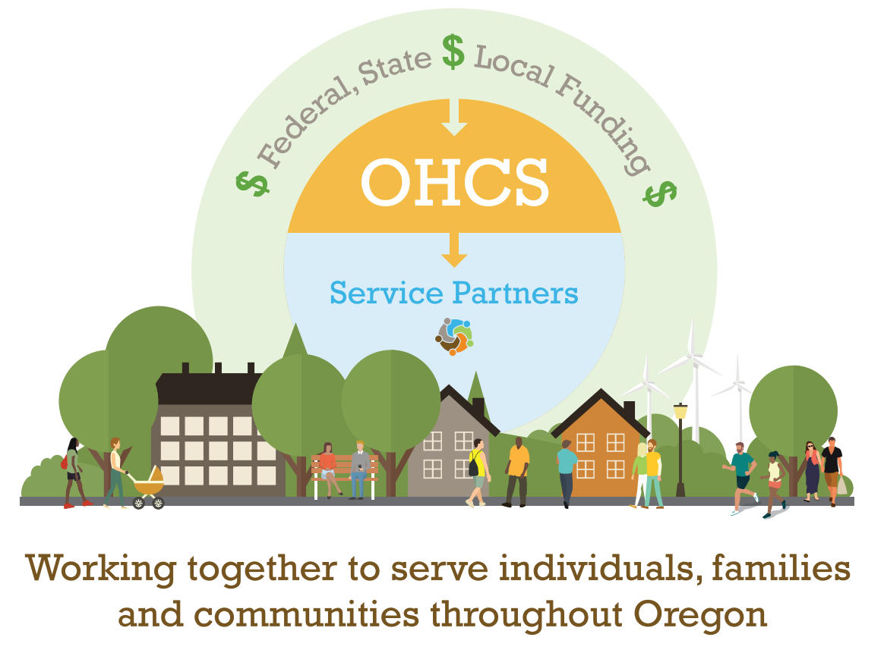
Oregon Housing & Community Services
Notes:
MS
To place this conversation in context, OHCS is not a direct service provider. We work to tie together resources from federal and state sources and we partner with local providers to serve individuals, families and communities throughout Oregon.

Slide 18
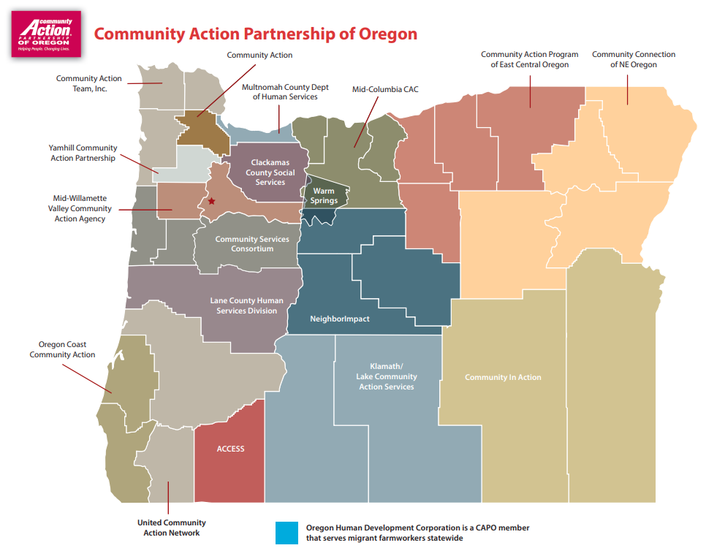
Community Action Agencies
Provide anti-poverty, homeless prevention, weatherization and energy assistance among other services. Each organization plays a unique and important role in their community.
To find the CAA in your area, you can search here.

Slide 19
Continuums of Care
Promote community-wide commitment to end homelessness and provide funding for non-profit providers. Responsibilities include managing Homeless Management Information Software (HMIS) and conducting the Point-in-Time Count (PIT) and Housing Inventory Count (HIC)
To find the CoC in your area, you can find their contact information here and you can data resources and other information at: https://www.oregon.gov/ohcs/homelessness/Pages/index.aspx

Slide 20
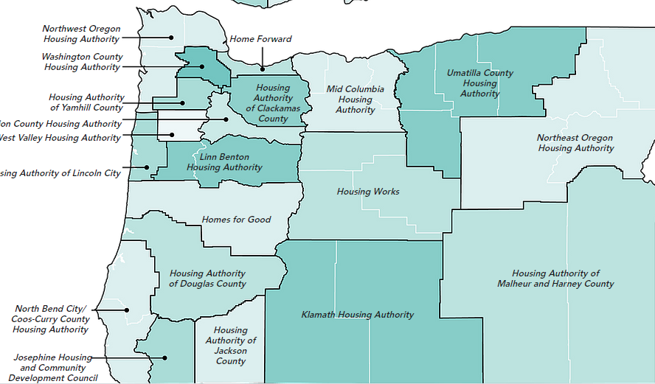
Housing Authorities of Oregon
These are generally by County or a group of Counties- they provide federal rental assistance programs, have relationships with landlords, and often own / manage affordable housing

Slide 21
Data Demonstrating the Need
Point-in-Time Count & Housing Inventory Count:
By Oregon County https://public.tableau.com/profile/oregon.housing.and.community.services#!/vizhome/2019Point-in-TimeDashboard/Story1
By Continuum of Care https://www.hudexchange.info/programs/hdx/pit-hic/data-reports/
Homeless Children from Oregon Department of Education: https://www.oregon.gov/ode/schools-and-districts/grants/esea/mckinney-vento/pages/default.aspx

Slide 22
Data Demonstrating the Need
Homelessness Research & Action Collaborative at Portland State University: https://www.pdx.edu/homelessness/research-1
Oregon Statewide Homeless Youth Needs Assessment & System Modeling:
https://www.oregon.gov/dhs/CHILDREN/Homeless-Youth/Pages/Oregon-Statewide-Homeless-Youth-Needs-Assessment.aspx

Slide 23
Shelter as Infrastructure
64.17% of all people experiencing homelessness live in unsheltered conditions
In 2018 Oregon was one of four states where more people are unsheltered than living in non-permanent locations
2019 Oregon Statewide Shelter Study identified a need of 5,814 additional shelter beds to provide relief to Oregonians (currently 4,174 permanent shelter beds)
Identified need to build capacity of communities to address the issues in their community and need for soft and capital resources
Notes:
MS
Before we share how shelter resources are serving communities throughout the state, I want to place the need for these resources in context. Oregon has a desperate need for shelter resources. Over 64% of people experiencing homelessness are without shelter. As we shared with this committee in September, the Shelter Study identified the need for more than 5800 shelter beds, which would more than double our existing infrastructure. Meeting this need will require multiple streams of resources, both for the construction and for on-going operation.
I’ll turn it over to Andrea Bell, Director of Housing Stabilization at OHCS, to talk more about the need for shelter.

Slide 24
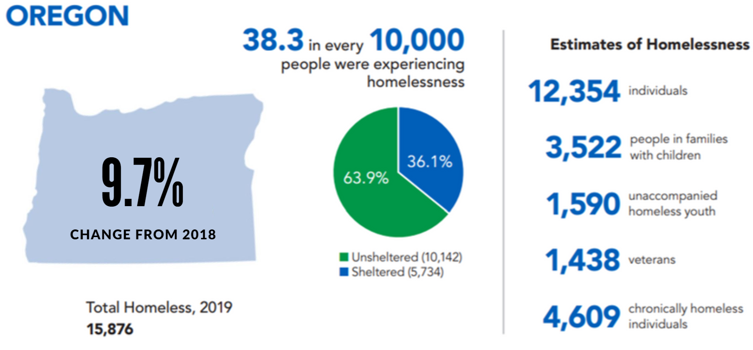
2019 Point-In-Time Count
Notes:
An important aspect of understanding the need is the Point in Time Count. The PIT is conducted the last week of January. It attempts to capture both sheltered and unsheltered persons experiencing homelessness to provide a snapshot of homelessness in the United States. The 2019 Point-In-Time Count data demonstrates the continued need for shelter across the state. While the Point-in-Time Count provides critical information about those who cannot find a permanent place to call home on a given night in January, it does not tell the full story of homelessness in each community. Please keep in mind that the Point-in-Time Count is an undercount. Counting those impacted by homelessness is difficult due to a variety of factors and the intention of the Count is to give a general sense of homeless trends in Oregon and across the country.

Slide 25
2019 Point-In-Time Count
25% of people experiencing homelessness are in the Portland Metro
Between 2015 and 2019, the estimated number of people experiencing homelessness across the state has increased 19%
People of color are overrepresented in the number of people experiencing homelessness
Black/African Americans make up of 1.9% of Oregon, but represent 6% of people experiencing homelessness
Native Americans make up of 2% of Oregon, but represent 5% of people experiencing homelessness
Notes:
AB
The OR PIT taught us a few things. First,
2nd highest unsheltered in the nation

Slide 26
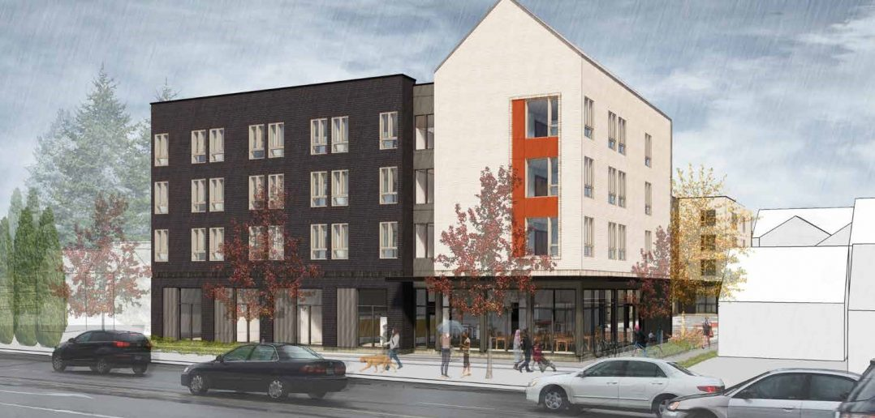
Every Front Door Needs a Back Door
Working towards ending homelessness in Oregon
Shelters need a back door, and that back door needs to exit people to housing
Permanent Supportive Housing
Affordable Rental Housing
$150M for the Local Innovation and Fast Track (LIFT) Housing Program in 2019
$25M for preservation of existing affordable housing in 2019
Notes:
MS
Every Front Door Needs a Back Door
Sisters LIFT example
Photo is of Northwest Housing Alternatives’ Gateway Workforce (LIFT project)

Slide 27
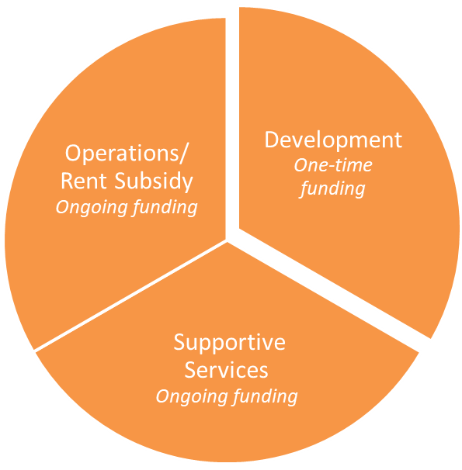
Permanent Supportive Housing
PSH is a proven effective, evidenced-based best practice that combines affordable housing with supports and services to more effectively serve the most vulnerable populations, including people who are or are at risk of homelessness or institutionalization.
Notes:
Natasha
Continue our PSH initiative
Rental assistance for 500 households in the first funding round, which are now current service level funded – these are additional resources for more households
We are working on developing this rent assistance framework, seeking input from housing authorities and homeless services providers
Services are in partnership with OHA
Are continuing our focus on training and technical assistance through our capacity building investments in CSH

Slide 28
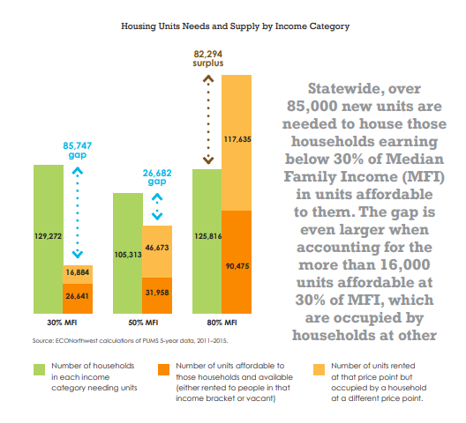
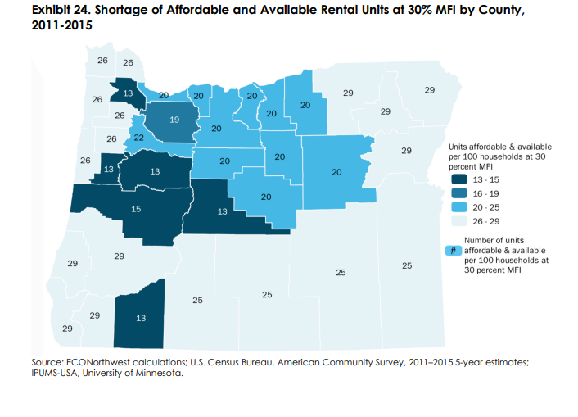
Statewide Need
Oregon is in a Housing Crisis…
Notes:
Reference SWHP
As Oregon’s Statewide Housing Plan outlines, more Oregonians are living in poverty now than during the Great Recession and 27% of Oregon renters have a severe housing cost burden. Oregon had a housing crisis before the fires with vacancy rates around 2%-3% in many areas of the state and some areas even lower than that. The massive loss of housing caused by the wildfires have only exacerbated this crisis. (Mention graphs.)

Slide 29
COVID-19 Eviction Moratorium, Renter Protections and Rental Assistance
The statewide eviction moratorium (HB 4401) will last until June 30, 2021. This means that, with limited exceptions, landlords cannot evict renters for nonpayment or without cause until July of 2021.
Renters must sign and return a form to their landlord if they can’t afford their rent. This form is available from the Oregon Judicial Branch. The Oregon Law Center has the form and more information in English and Spanish​.
SB 282, effective May 19, 2021 extends the timeline for Oregon renters to repay back rent accrued during the 2020 pandemic to February 28, 2022. In addition to the repayment period extension, this legislation also temporarily allows families to share housing that would be in violation of landlord-imposed occupancy limits and protects against the use of COVID-era rental and credit records when tenants apply to rent in the future.

Slide 30
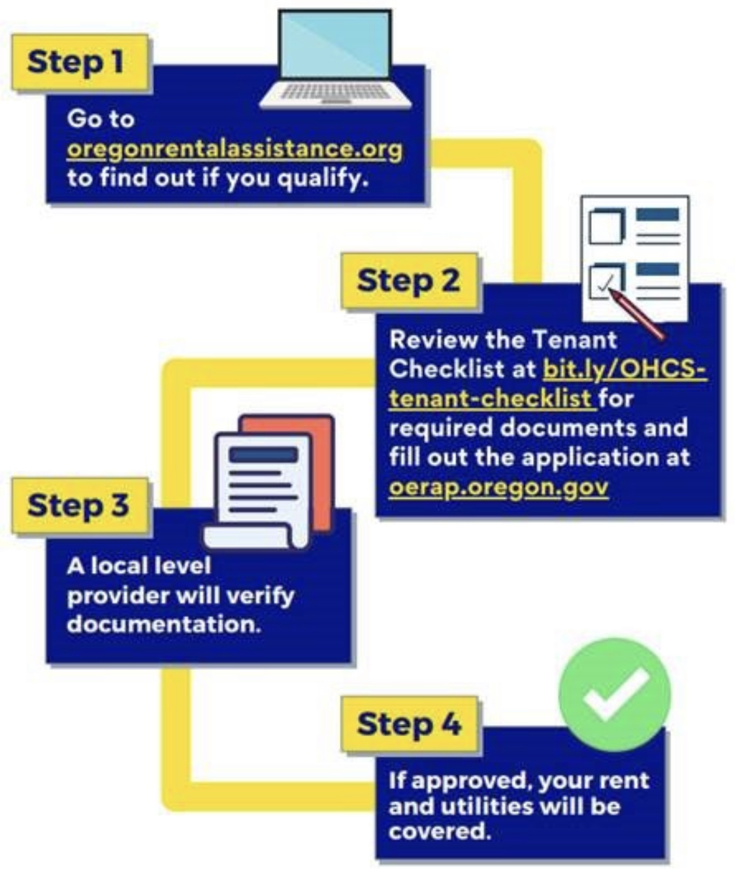
COVID-19 Eviction Moratorium, Renter Protections and Rental Assistance
Starting Wednesday, May 19th, qualified renters may begin submitting applications to the Oregon Emergency Rental Assistance Program (OERAP) for funding to pay rent, rent arrears, future rent and certain home utility costs.
OHCS will distribute $204 million to qualified renters who have experienced financial hardship due to the coronavirus pandemic and are at risk of homelessness or housing instability.

Slide 31
COVID-19 Eviction Moratorium, Renter Protections and Rental Assistance
We know that there is a disproportionate impact to BIPOC communities throughout our state. OHCS has created a landing page with Social media tiles & YouTube videos available in 18 languages here: https://www.oregon.gov/ohcs/housing-assistance/Pages/eviction-social-media-kit.aspx
For more information about the eviction mortarium which includes a video, a copy of the declaration, and lots of other information please go to the Oregon Law Center’s website

Slide 32
Thank you
CONCLUSION
Membership and Mission
The following elements provide a strong foundation and positive first step as we begin our journey in implementing an outcomes-oriented approach for Oregon’s homeless services system.
Oregon Housing & Community Services (OHCS) wants to connect with you
CONTACT:
Connor McDonnell
Housing Integrator
Connor.McDonnell@oregon.gov
Notes:
MS

Slide 33
Future LOC Programming and Resources on Housing and Homelessness
Zoom Poll
Discussion – Additional Questions and Suggestions
Resources? Training?
LOC conference topics?
Add your questions and suggestions to the chat!

