Slide 1


Legislative Updates: 2026 Session Concludes
March 13, 2026

Slide 2
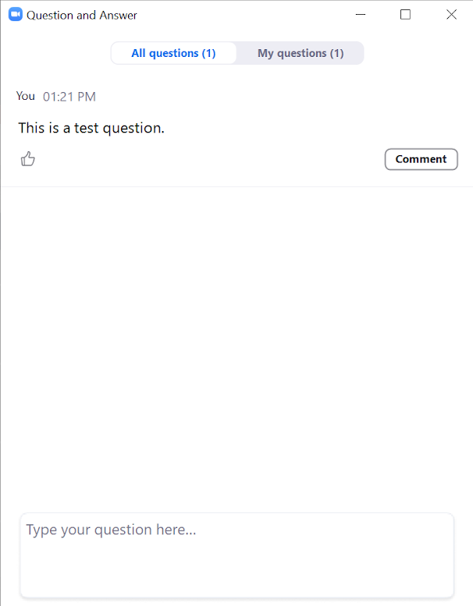
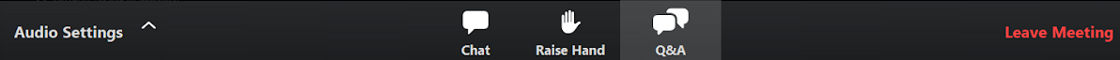
Webinar Logistics
Submit your questions any time during the presentation.
We will answer questions from the Q+A feature first, then live questions as we have time at the end. We are prioritizing question from members related to bills in the 2026 legislative session.
Notes:
Please put ?s in Q+A feature as we go
We will take live questions at the end as there is time

Slide 3
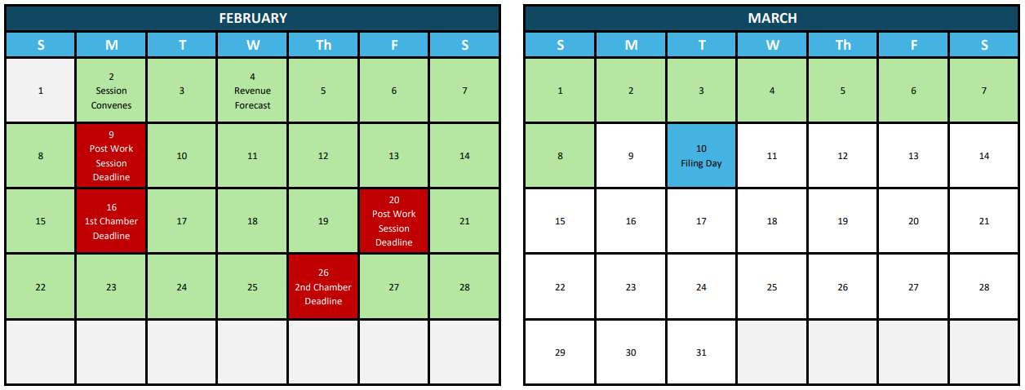


Legislative Timeline
4:17 PM
Notes:
-evening floors
-ways and means
-walk out
-progress
-wait on budget
Turn to scott to walk through the first 2 action alerts

Slide 4
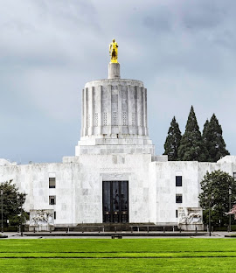
OGEC
2026 Session in the rearview
33 days, 304 measures introduced with 599 amendments, 104 bills passed
Progress on LOC priorities and working to limit negative impact of other legislation
Laying groundwork for important conversations in 2027: transportation, revenue, technology, more!

Slide 5
OGEC
Budget Summary: The Cuts
Session started with $750M deficit that was addressed by:
Disconnect package - $311M no longer forgone given changes in H. R. 1
Improved revenue forecast - $650M up from previous forecast
H.R 1 implementation clarity – update figures from agencies
Agency reductions – holding roles vacant and cutting services/supplies
ODOT’s $288M reductions due to transportation package referral:
Grant program pauses – multiple programs impacted, with Connect Oregon and Safe Routes to School maintaining some funds
Fund redirection – statutes waived, projects paused and one cancelled
Agency reductions – holding roles vacant and cutting services/supplies

Slide 6
OGEC
Budget Summary: The Adds
Bonding Investments
Up to $367.6M in bonds or certificates of participation to finance capital improvements at the Moda Center
$84.6M lottery bonds to support 24 project total
  14 city projects receive new funds, ~$38M
General Fund
$10M for Regional Infrastructure Fund (pop. <25K)
$6M for 2027 wildfire season
$5M for Industrial Site Loan Fund
Notes:
INCREASES: https://olis.oregonlegislature.gov/liz/2026R1/Downloads/CommitteeMeetingDocument/315809

Slide 7
Transportation Bills
HB 4007 - regulates micromobility devices
SB 1544 - expands eligibility for transit funding and modified dismantler requirements
SB 1599 - moves the date of the transportation tax referendum, passed both chambers and signed by the Governor – legal challenge update
Contact: Nicole Stingh, nstingh@oregoncities.org
Notes:
Thanks for engaging on HB 4085, your voices were heard and the bill will not receive further action this session
Amendments in HB 4007 restore local control and is expected to be adopted Monday when the bill moves out of committee
The other bills listed are still alive and under consideration, will not discuss those

Slide 8
Revenue & Finance Bills
SB 1507 - federal disconnect package
HB 4178 - rounding policy given penny shortage, requires cities to notice and post policies if used
LOCAL Act (HB 4148) - creates flexibility for use of transient lodging tax revenue, LOC priority bill
Contacts: Nicole Stingh, nstingh@oregoncities.org & Scott Winkles, swinkels@orcities.org
Notes:
Federal disconnect: passed out of committee this week. Bill keeps OR connected to no tax on overtime/tips, but disconnects Oregon from Vehicle loan interest deduction disconnect ($36.4M +this bi) Qualified small business stock disconnect ($38.9M +) Bonus depreciation disconnect ($267.0M +). THEN the bill invests in ab earned income tax credit expansion ($26.2M - ) and creates a credit for taxpayers creating jobs ($4.6M – )

Slide 9
Public Safety Bills
HB 4138 - Requires unmasking for law enforcement, includes exemptions for health/safety or undercover needs
SB 1516 - Establishes Automated License Plate Reader regulations
HB 4099 – Creates the Task Force on Responding to Veterans in Crisis, includes one city representative
Contact: Scott Winkles, swinkels@orcities.org

Slide 10
Ethics Package
The Oregon Government Ethics Commission package, LOC priority bills:
HB 4161: Exempts food and beverages from the prohibited use of office statute
HB 4177: Simplifies the serial meeting laws passed in 2023
HB 4159: Requires the governor's appointee to the OGEC to have local government experience
Links: HB 4161, HB 4177, and HB 4159
Contact: Scott Winkles, swinkels@orcities.org

Slide 11
General Government Updates
HB 4016 – Contractor Tax Compliance, amended to remove cities.
SB 1517 - Recreational Liability Waivers, Compromise reached.
HB 4089 - Increases penalties in Wage Theft/Licensure Law, adopted LOC amendments
Contact: Greg Miller, gmiller@orcities.org

Slide 12
Energy & Telecom
Updates
HB 4031 - Expedited Citing of Renewable Energy Facilities
HB 4076A - “Gut and Stuff”, expedites "surplus energy generation" projects for projects with a current EFSC certificate. Amendment preempts local government permitting on EFU land.
Contact: Greg Miller, gmiller@oregoncities.org

Slide 13
Housing & Economic Development Bills
HB 4037 – Omnibus housing bill
HB 4035 – One-time UGB Expansion Program Update
HB 4082 – One-time UGB Expansions for Manufactured Homes and Senior Housing
HB 4084 – Gov. Kotek’s Prosperity Roadmap Package
Contact: Alexandra Ring, aring@oregoncities.org

Slide 14
Water, Waste, & Natural Resources, & Solid Waste Bills
HB 4005 – Water Professional Appreciation Week (starts every first Saturday in October).
SB 1585 – Reduces grant matching requirements for cities, LOC priority bill
HB 4144 – Battery Producer Responsibility.
Contact: Michael Martin, mmartin@oregoncities.org

Slide 15
OGEC
What’s Next
Session summary report release expected in April – watch for city action items
Policy Committees are now meeting to develop the 2027-28 LOC Legislative Priorities
An update to the Oregon Municipal Policy – revisions coming this year to update in 2027
Register for the LOC Spring Conference in Pendleton April 23-24!
Early bird registration closes April 3, registration is open until April 10

Slide 16

Questions?

Slide 17
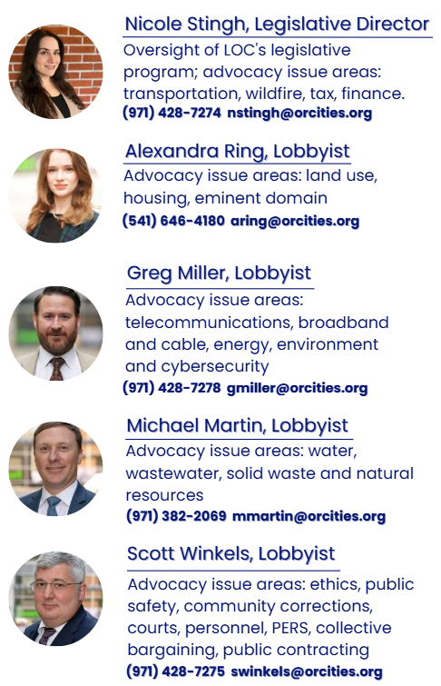
Your
LOC
Lobby Team

