Slide 1
Infrastructure Investment and Jobs Act Implications for Oregon’s Local Governments
December 15, 2021
9-10 am
1
Notes:
Congress recently passed the Infrastructure Investment and Jobs Act, a historic investment in the nation’s infrastructure, including transportation.

Slide 2
How to Ask Questions
Go to www.slido.com
Enter event code: #localinfrastructure
Submit a question or vote for a question that’s already there
We’ll focus on the most popular questions and get to as many as we can

Slide 3
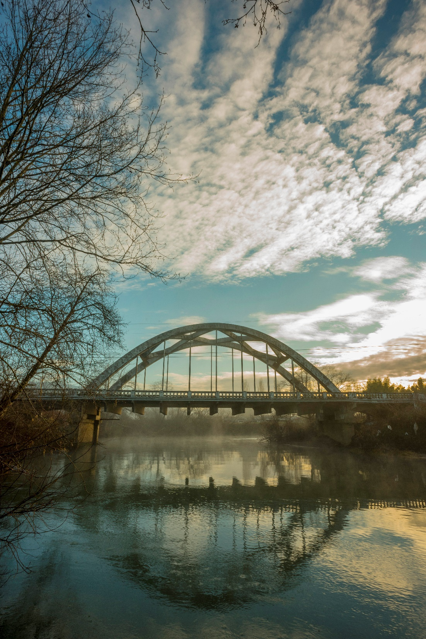
IIJA Basics
$1 TRILLION for infrastructure
$567 billion for transportation
Surface transportation portion includes:
Reauthorization of surface transportation programs
New programs for resilience and climate
Special funding for bridges and EV charging
Huge amount of discretionary grants
All over five years (2022-2026)
Notes:
The IIJA is a $1 trillion package funding all types of infrastructure– from transportation to water and wastewater and even broadband.
About half of the funding goes to transportation, which will nearly double federal investment in transportation across all modes.
The transportation portion includes:
Reauthorization of the base surface transportation programs in the FAST Act
New formula programs and funding for resilience and climate
Special one-time infrastructure package funding for bridges and EV charging
Significant opportunities to apply to US DOT for discretionary grants
All of this will come over the course of five years-- 2022-2026.

Slide 4
Oregon Transportation Funding Under IIJAg
Highways/Special Programs
$1 billion in additional funding over 5 years– a 38% increase
Public Transportation
$200 million in additional funding over 5 years– a 35% increase
Notes:
The infrastructure bill includes a reauthorization and extension of the surface transportation programs as well as increased funding for these programs.
This will translate into a total of about $1 billion in additional highway and special program formula funding for Oregon over the next 5 years—a nearly 40% increase in federal investment to preserve and improve the system.
It will also mean nearly $200 million in additional funding for public transportation over 5 years, an increase of more than one third.
Note: All of the funding numbers we use throughout this presentation will be 5 year totals.

Slide 5
Additional IIJA Funding Compared to HB 2017 In millions of dollars in state and federal FY 2026
Notes:
While the IIJA is a historic investment, it’s important to put it into context. If you compare the IIJA in its last year to the same year of HB 2017, HB 2017 is about two and a half times larger.

Slide 6
IIJA Programs

Slide 7
Local Programs Breakdown Additional Estimated Total Funding Over 5 Years
Statewide Programs
Discretionary Grant Programs
Safety (ARTS): $20m
Local Bridge: $34m (plus special bridge funding)
Bicycle/pedestrian: $20m
Formula Programs
CMAQ: $8m
MPO planning: $6m
STBG fund share with cities/counties/small MPOs: $32m
Transportation Management Areas
Surface Transportation Block Grants: $30m
Transportation Alternatives: $11m
Carbon Reduction: $27m
Notes:
Local governments will receive significant increases in funding in a wide variety of programs. ODOT estimates that this will amount to at least $200 million in additional funding. This is the funding that will be provided automatically, before we factor in some additional investments, like the special Bridge funding and the Carbon Reduction Program.
Here are some of the specifics. These are all estimates, but are probably within plus or minus 10%.
Local governments will receive:
Additional funding for safety projects through the All Roads Transportation Safety Program.
Additional funding for the Local Bridge Program.
Additional funding for Community Paths through Transportation Alternatives.
Congestion Mitigation and Air Quality Improvement program that goes to areas that have air quality challenges.
Additional funding through ODOT’s fund-sharing agreement with cities, counties, and small MPOs.
Much of the local funding will go to the three large urban areas– Portland, Salem and Eugene. They’ll receive a total of nearly $70 million in additional funding directly suballocated to them by formula in federal law through the Surface Transportation Block Grant funds, Transportation Alternatives, and the new Carbon Reduction Program.

Slide 8
Improving Safety for All
$45 million in additional funding for the All Roads Transportation Safety (ARTS) Program to make state and local roads safer for all users
Traditionally split about half and half between state highways and local roads
Funding distributed through data-driven strategic process to most cost-effective safety projects
Notes:
The bill will provide more than $45 million in additional funding for the All Roads Transportation Safety (ARTS) program to make our roads safer for all users. ARTS uses a data-driven approach to find the most cost-effective ways of directing funding to reduce fatalities and serious injuries for all users on all roads, whether owned by ODOT, a county, or a city.

Slide 9
Bridges
More than a quarter billion dollars in additional direct investment in repairing and replacing Oregon’s bridges
Funding expected to be split between ODOT and local governments using historic shares
$34m in additional funding for Local Bridge Program out of base IIJA funding
ODOT will put bridges into State Funded Local Program
4
Notes:
The IIJA will provide Oregon more than a quarter billion dollars to preserve and replace aging bridges on state highways and local roads.
The majority of ODOT's bridges are over 50 years old-- the age at which they should be heading toward retirement. With a huge number of bridges reaching the end of their lifespan, we are currently only investing about one-third of what we need to keep them in a state of good repair. We have about 2800 bridges on the state highway system, and we’re currently replacing about 3 per year– for a replacement cycle of nearly 900 years.
While this is a significant infusion of resources, at about $50 million a year it is about a one-third increase in the State Bridge Program. Given the massive needs for our aging bridges, even with this additional infusion of funding we still expect to see bridge conditions deteriorate over time.

Slide 10
STBG Fund Sharing Agreement
Additional $32 million over 5 years shared with counties, cities, and small MPOs
ODOT, AOC, LOC discussing potential improvements
ODOT does not have state cash to expand fund exchange

Slide 11
Improving Active Transportation
$30 million in additional direct funding for bicycle and pedestrian programs under Transportation Alternatives Program
TA funding will be suballocated by formula to Oregon’s three large MPOs
ODOT must use the funding for grants to local governments
Funding will likely go to the Community Paths program
Notes:
Approximately $30 million in additional funding will go to the Transportation Alternative Program. Some of this goes directly to the three large MPOs; most of this is run through the Oregon Community Paths program to provide grants to local governments.

Slide 12
Public Transportation
Nearly $200 million in additional funding for public transportation in rural and urban communities
Most funding goes directly to large urban areas
ODOT’s funding for rural areas and seniors and people with disabilities will expand
Notes:
Urban and rural areas will see nearly $200 million in additional formula funding. There will be significant discretionary grant opportunities as well, including funding for Bus and Bus Facilities.
And the bill dedicates significant discretionary grants that will make investments in passenger rail. Some of this could be used to help improve the frequency, travel times, and reliability of service on the Cascades Amtrak corridor between Eugene, Portland, Seattle, and Vancouver, British Columbia.
2021 2026 % Increase
Portland* $ 76,504,447 $ 105,708,354 38%
Salem $ 4,901,922 $ 6,892,996 41%
Eugene $ 10,015,910 $ 14,013,877 40%
Bend $ 1,666,505 $ 2,345,747 41%
Medford $ 3,334,560 $ 4,694,729 41%
Corvallis $ 2,282,880 $ 3,226,271 41%
Albany $ 1,200,710 $ 1,689,941 41%
Grants Pass $ 1,011,243 $ 1,424,611 41%
*Includes Vancouver, WA funding.

Slide 13
Electric Vehicle Charging Stations
$52 million in formula funding to expand availability of electric vehicle charging stations
Focused on designated alternative fuel corridors
$2.5 billion in competitive grants also available from US DOT
Notes:
Let’s walk through the various formula programs that are included in the bill.
Transportation is the largest source of greenhouse gas emissions in Oregon– about 40% of our total. The bill makes the most significant investments to date in reducing these emissions to help achieve our climate commitments.
The bill will dedicate $52 million in funding for electric vehicle charging stations. It will also provide $82 million for a new Carbon Reduction Program. Some of this Carbon Reduction Program money will go directly to the three large MPOs.

Slide 14
Carbon Reduction Program
$82 million for a new Carbon Reduction Program to help achieve our climate commitments
Funding split approximately into thirds:
Funding suballocated by formula to Oregon’s three large MPOs
ODOT intends to provide a portion of funding as grants to local governments outside these MPOs
Remainder of funds for statewide programs

Slide 15
IIJA Additional Funding for Oregon $1.2 billion total
Notes:
When you look at the $1.2 billion in additional funding that will come to Oregon, about about a quarter will go to sustainable transportation programs– transit, active transportation, and the new Carbon Reduction and EV Charging programs.
A similar portion will go to Fix-It programs for Bridges and Resilience.
The remainder will go to Safety and Local and some other miscellaneous areas. It’s important to note that local governments will get a lot more than 9%-- they’ll get some of the funding that comes in as other categories, including Carbon Reduction, Safety, Active Transportation, and Bridge.
That leaves about 1/3 of funding that will be available as flexible funding for the OTC to allocate. That amounts to about $400 million.
(Note: Local here only includes CMAQ, MPO Planning, STBG to TMA, STBG via AOC/LOC, and Local Bridge.)

Slide 16
How to Follow IIJA
Visit ODOT’s IIJA website at www.oregon.gov/odot/Pages/IIJA.aspx
Subscribe to ODOT’s STIP update list at public.govdelivery.com/accounts/ ORDOT/subscriber/topics

Slide 17
How to Provide Feedback
Submit comments and letters through OTC website at www.oregon.gov/odot/Get-Involved/Pages/OTC-Comments.aspx
Watch for online open house in February
Provide public comment at OTC meetings
January 20
February 17 (special meeting on IIJA)
March 10
March 30 (special meeting on IIJA)

Slide 18
Questions?
Go to Slido.com and enter event code #localinfrastructure

